Slide 1
Software Defined Radio (SDR)

Slide 2
SDR Exercise #01
GQRX: Find a Radio Station / Key Fob

Slide 3

SDR Exercise #01 – Step 1
Plugin and ensure HackRF is working
Plugin hackRF
Ensure hackRF is connected
hackrf_info

Slide 4
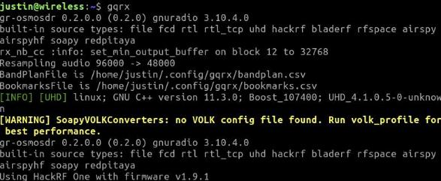

SDR Exercise #01 – Step 2 Launch the GQRX application
Terminal
GUI
Click “Application Menu” in bottom left corner
In the Search box type “gqrx” to ﬁnd the application
Click on the Gqrx application to run it
1. Type the command below
gqrx
Terminal
GUI
DO NOT COPY OR REPRODUCE

Slide 5
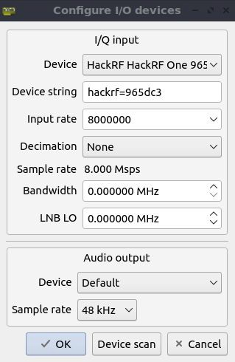
SDR Exercise #01 – Step 3
Conﬁgure I/O Devices (GQRX Settings)
Set Device to hackrf=######
Set Input Rate to 8000000
(8 mega samples per second)
This is the Sample rate

Slide 6
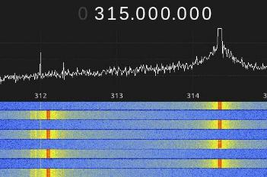
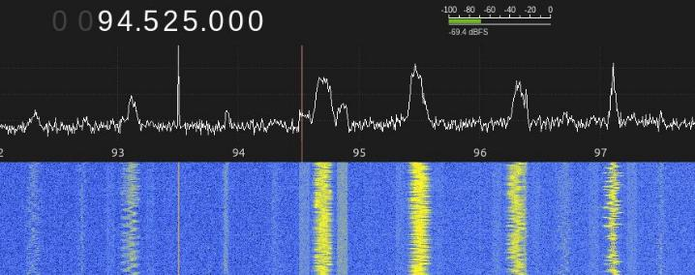
SDR Exercise #01 – Step 4
Find radio station / Key Fob Signal
Change Mode to WFM (stereo)
Tune to your favorite radio station
100.3 MHz / 95.5 MHz / 97.9 MHz / 106.7 MHz / 92.3 MHz
3. Click the Play icon in the upper left hand corner
Find a Key Fob Signal [FSK]
Find a radio station
DO NOT COPY OR REPRODUCE

Slide 7
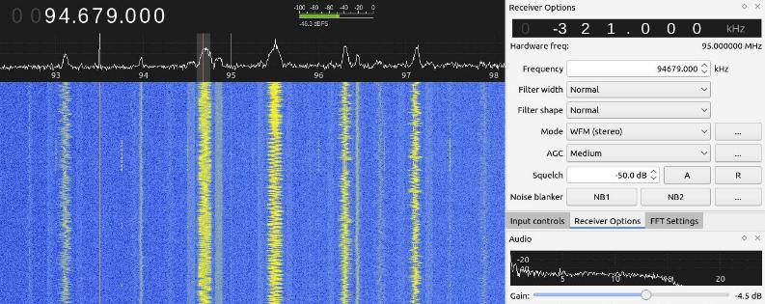
SDR Exercise #01 – Step 5 Tune your signal
Select an area where there's a signal to tune into (solid line or blurbs)
Turn up the Gain (volume) in the bottom right hand corner
Under Squelch click ‘A’ then click the down arrow a few to remove noise
DO NOT COPY ORREPRODUCE

Slide 8
SDR Exercise #02
Record a Key Fob Signal (basic_capture)
DO NOT COPY OR REPRODUCE

Slide 9
SDR Exercise #02 – Step 1
Plugin and ensure HackRF is working
Plugin hackRF
Ensure hackRF is connected
hackrf_info
DO NOT COPY OR REPRODUCE

Slide 10
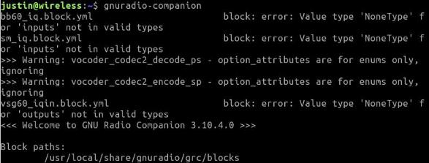

SDR Exercise #02 – Step 2
Launch the GNU Radio Companion application
Terminal
1. Type the command below
gnuradio-companion
GUI
Click “Application Menu” in bottom left corner
In the Search box type “gnuradio” to ﬁnd the application
Click on the Gqrx application to run it
Terminal
GUI
DO NOT COPY OR REPRODUCE

Slide 11
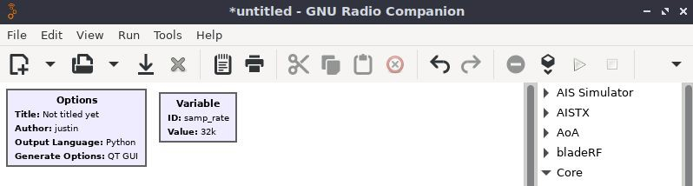
SDR Exercise #02 – Step 3 New project created
1. Once GNU Radio launches, it will create a new untitled project
DO NOT COPY OR REPRODUCE

Slide 12
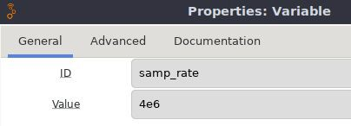
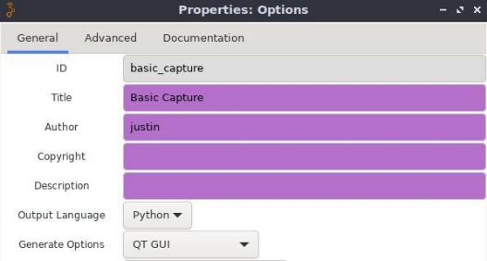
SDR Exercise #02 – Step 4 Edit default values
Options
Variable
ID: basic_capture
Title: Basic Capture
Author: Your Name
ID: samp_rate
Value: 4e6
DO NOT COPY OR REPRODUCE

Slide 13
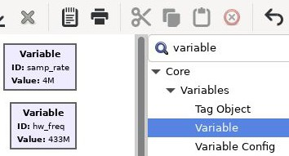
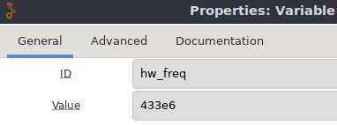
SDR Exercise #02 – Step 5 Create a new Variable
Click in the Function Blocks area then press CTRL+F to open the
search prompt
Type variable to ﬁnd the variable block, double-click to add to
canvas.
3. Double-click new Variable to edit the values.
ID: hw_freq
Value: 433e6
DO NOT COPY OR REPRODUCE

Slide 14
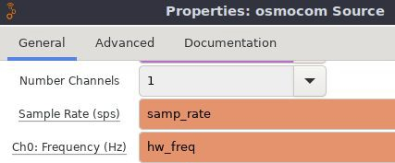
SDR Exercise #02 – Step 6
Add a SDR as a source for receiving
Click in the Function Blocks area then press CTRL+F to open the search
prompt
Type osmocom to ﬁnd the osmocom source block, double-click to add to canvas. Double-click again to edit the values.
Edit Ch0: Frequency (Hz) to be the hw_freq variable, samp_rate should be set
DO NOT COPY OR REPRODUCE

Slide 15
SDR Exercise #02 – Step 7 Continue adding blocks
Click in the Function Blocks area then press CTRL+F to open the search
prompt to ﬁnd the following blocks:
  File Sink
  QT GUI Frequency Sink
  QT GUI Time Sink
Create a replica of the GNU Radio project called basic_capture shown on the next page.
DO NOT COPY OR REPRODUCE

Slide 16
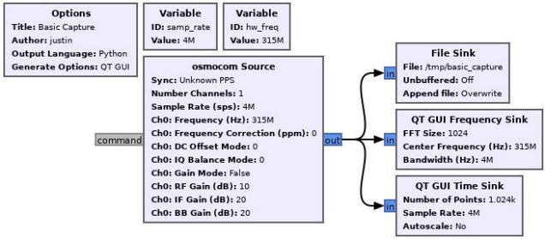

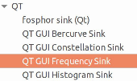
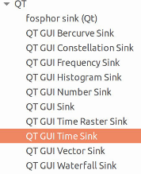


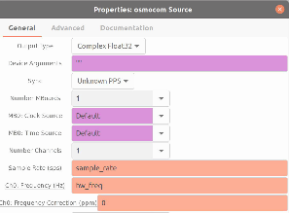
SDR Exercise #02 – Step 8 Duplicate Basic Capture Project
WITHOUT SLIDERS
DO NOT COPY OR REPRODUCE

Slide 17
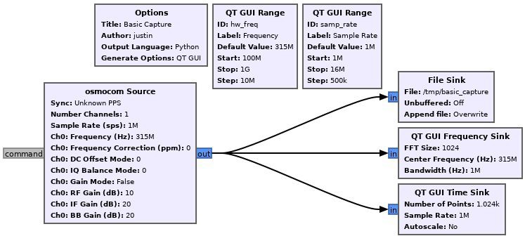
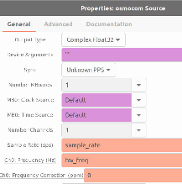
SDR Exercise #02 – Step 8 Duplicate Basic Capture Project
WITH SLIDERS
DO NOT COPY OR
REPRODUCE

Slide 18
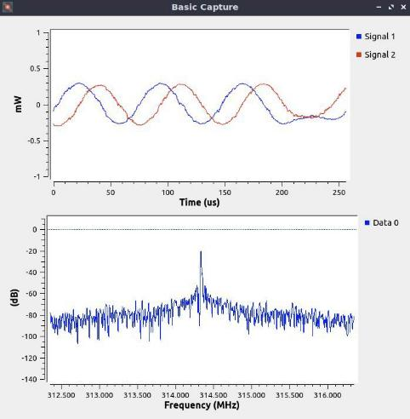
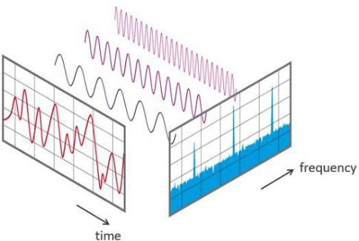
SDR Exercise #02 – Step 9 Execute Basic Capture Project
WITHOUT SLIDERS
DO NOT COPY OR REPRODUCE

Slide 19
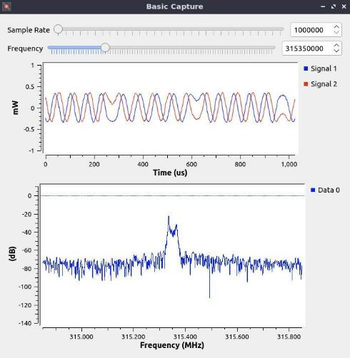
SDR Exercise #02 – Step 9 Execute Basic Capture Project
WITH SLIDERS
DO NOT COPY OR REPRODUCE

Slide 20

SDR Exercise #03
Replay a Key Fob Signal (basic_replay)
DO NOT COPY OR REPRODUCE

Slide 21
SDR Exercise #03 – Step 1
Plugin and ensure HackRF is working
Plugin hackRF
Ensure hackRF is connected
hackrf_info
DO NOT COPY OR REPRODUCE

Slide 22
SDR Exercise #03 – Step 2
Launch the GNU Radio Companion application
Terminal
1. Type the command below
gnuradio-companion
GUI
Click “Application Menu” in bottom left corner
In the Search box type “gnuradio” to ﬁnd the application
Click on the Gqrx application to run it
Terminal
GUI
DO NOT COPY OR REPRODUCE

Slide 23
SDR Exercise #03 – Step 3 New project created
1. Once GNU Radio launches, it will create a new untitled project
DO NOT COPY OR REPRODUCE

Slide 24
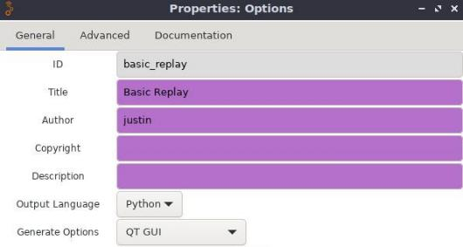
SDR Exercise #03 – Step 4 Edit default values
Options
Variable
ID: basic_replay
Title: Basic Replay
Author: Your Name
ID: samp_rate
Value: 4e6
DO NOT COPY OR REPRODUCE

Slide 25
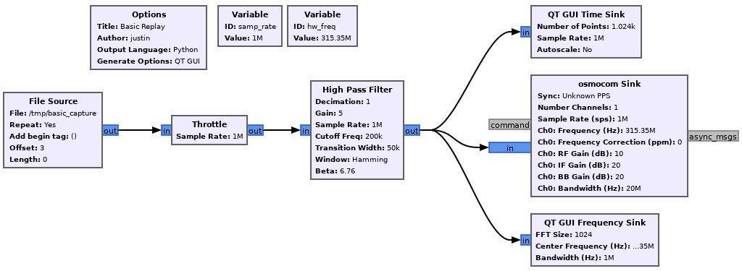
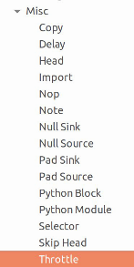
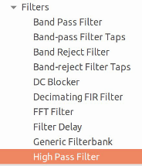
SDR Exercise #03 – Step 5 Duplicate Basic Replay Project
WITHOUT SLIDERS
DO NOT COPY OR REPRODUCE

Slide 26
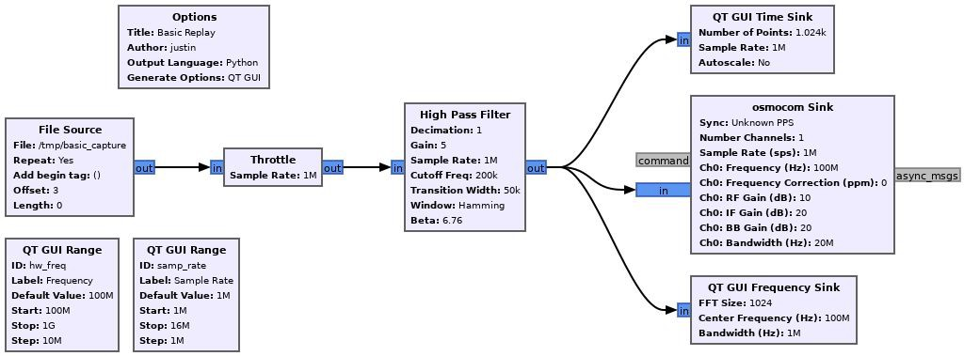
SDR Exercise #03 – Step 5 Duplicate Basic Replay Project
WITH SLIDERS
DO NOT COPY OR REPRODUCE

Slide 27
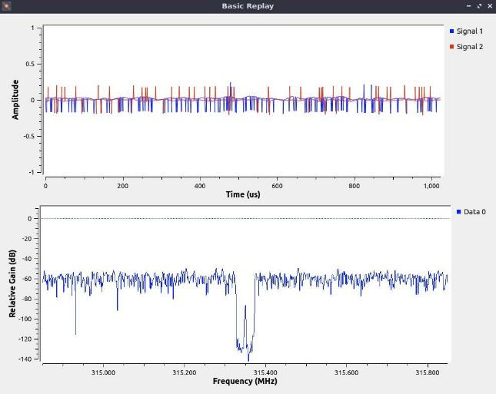
SDR Exercise #03 – Step 6 Execute Basic Replay Project
WITHOUT SLIDERS
DO NOT COPY OR REPRODUCE

Slide 28
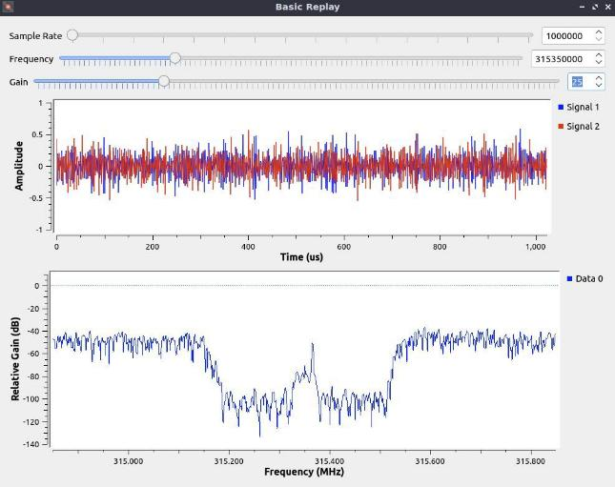
SDR Exercise #03 – Step 6 Execute Basic Replay Project
WITH SLIDERS
DO NOT COPY OR REPRODUCE

Slide 29
SDR Exercise #04
Decode Key Fob Signal (advanced_capture)
DO NOT COPY OR REPRODUCE

Slide 30
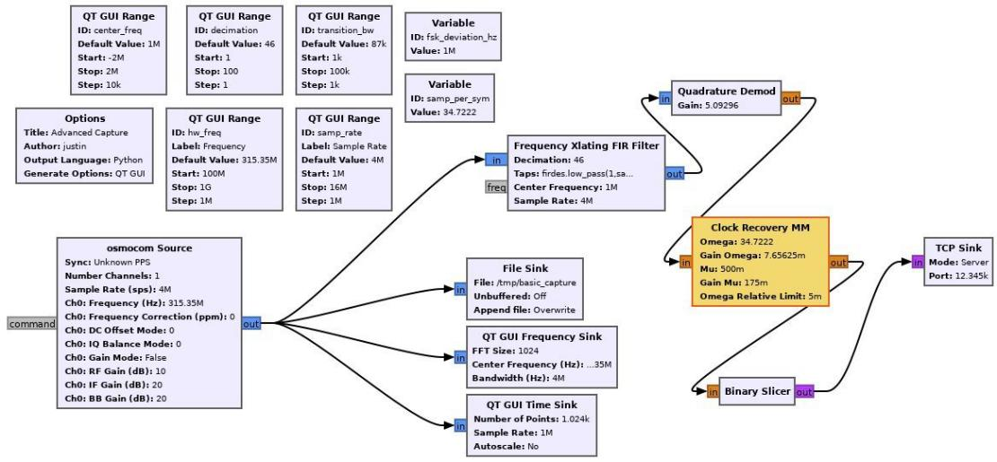
SDR Exercise #04 – Step 1 Duplicate Advanced Capture Project
DO NOT COPY OR REPRODUCE
DO NOT COPY OR
REPRODUCE

Slide 31
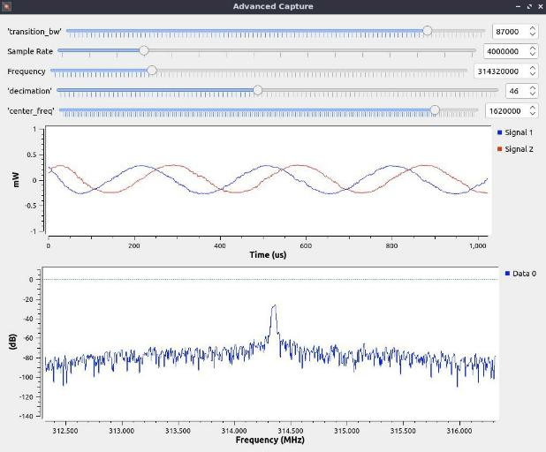
SDR Exercise #04 – Step 2 Execute Advanced Capture Project
DO NOT COPY OR REPRODUCE

Slide 32
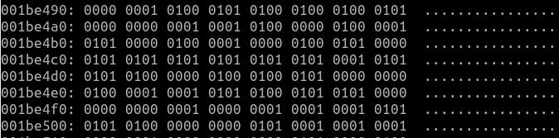
SDR Exercise #04 – Step 3
View Binary data feed from Advanced Capture
Open a terminal window
Type the following commands to view data feed of a signal
nc 127.0.0.1 12345 | xxd
nc 127.0.0.1 12345 | xxd | grep 101
Press a button on the key fob to see the binary data feed
DO NOT COPY OR REPRODUCE

Slide 33
Software Defined Radio (SDR)

Slide 34
SDR Information
Software Defined Radios (SDR)
  https://en.wikipedia.org/wiki/Software-defined_radio
  http://www.arrl.org/software-defined-radio
  Not limited by single purpose hardware
  Various software packages
  Use to sniff and diagnose wireless data and frequencies
  Can be used to decode and encode data
  Can also be used to transmit data for testing or spoofing
  Popular with engineers and hackers
  Freedom of access to RF spectrum
  Exposes protocols previously inaccessible
  Hugely flexible, but requires a lot of work
  Requires programming and real-time signal processing
    FFT, Spectrum
    Waterfall display
  Not a first avenue of attack

Slide 35
SDR Hardware
Hardware
  Choices to fit specific applications
  https://www.rtl-sdr.com/roundup-software-defined-radios/
  Cheap, usually under $500
  Usually multi-platform and open source support
  RTL-SDR
    Cheapest, but RX only ($10-20)
    https://www.rtl-sdr.com/
    Originally for DVB-T TV tuning
  HackRF & YARD Stick One
    Michael Ossman
    https://greatscottgadgets.com/hackrf/
    Teaches BlackHat class
  BladeRF
    40MHz bandwidth
    https://www.nuand.com/
    OpenBTS and OpenLTE support
  LimeSDR & LimeSDR Mini
    Crowd sourced
    https://www.crowdsupply.com/lime-micro/limesdr-mini
    Full duplex
  Airspy
    RTL-SDR features
    https://airspy.com/
    RX only, fast scanning
  Ettus
    Commercial product
  SDRPlay RSP*
    https://www.sdrplay.com/
  USRP
    Oldest SDR, more expensive

Slide 36
SDR Software
Software
  Many software packages available, but those are the most prominent
  GNU Radio
    https://www.gnuradio.org/
    Block Diagramming of radio logic
      Lots of 3rd party blocks
    Works with most SDRs
  GQRX Visualization
    Multiplatform
    http://gqrx.dk/
    Spectrum, Waterfall display
  SDR-Radio
    http://www.sdr-radio.com/
  SDR# (Windows only)
    Real-time FFT, Waterfall display
    https://airspy.com/
    Plug-in support
    Closed source
    AirSpy

Slide 37
SDR Applications
Applications/Examples
  https://www.rtl-sdr.com/tag/applications-2/
  Increasingly used by HAM Radio transceivers
  AM/FM Radio
  FAA ADS-B Messages
  Keyfob hacking
  Stingray catcher (MITM Rogue Cell tower)
  …

